Slide 1

Big Data Project Classification on Fit-Bit Data
Name: Ashwini Choudhary
Course: MSc Big Data and Business Analytics
Supervisor: Prof.Madan Radhakrishna

Slide 2
Introduction
This project was based on fitbit data published on Kaggle I tried to make classification based on running and fitness
activities if the person is Fit, Unfit or Moderately Fit.
conducted using Databricks, with PySpark and Python.

Slide 3
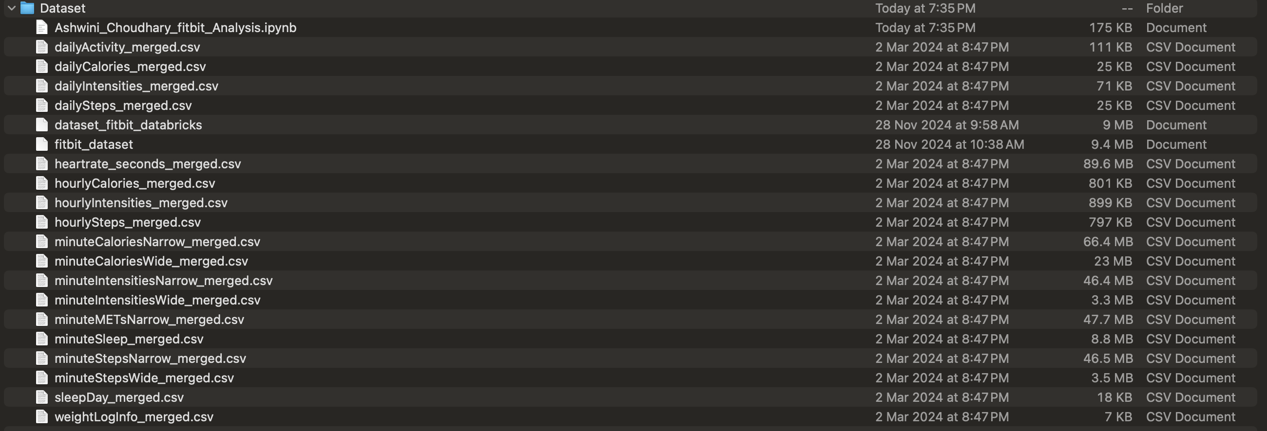
Dataset

Slide 4
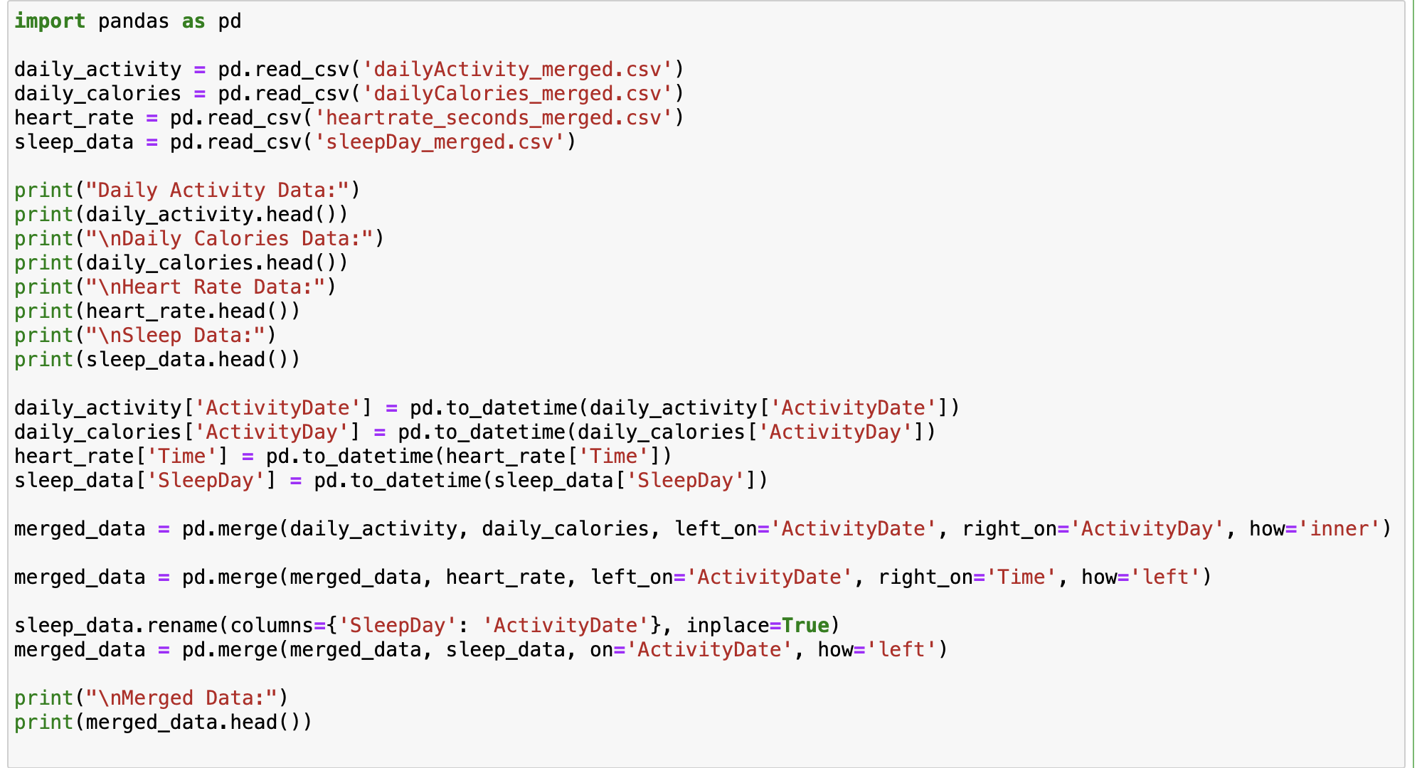
Merging Dataset

Slide 5
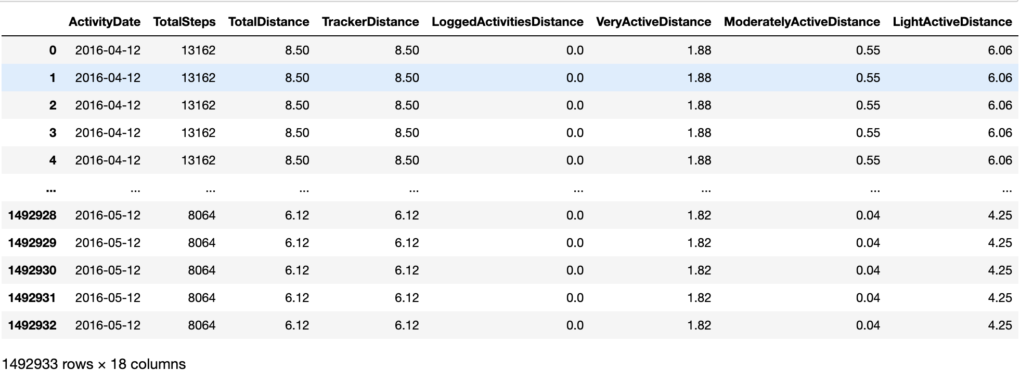
Inconsistent Data

Slide 6
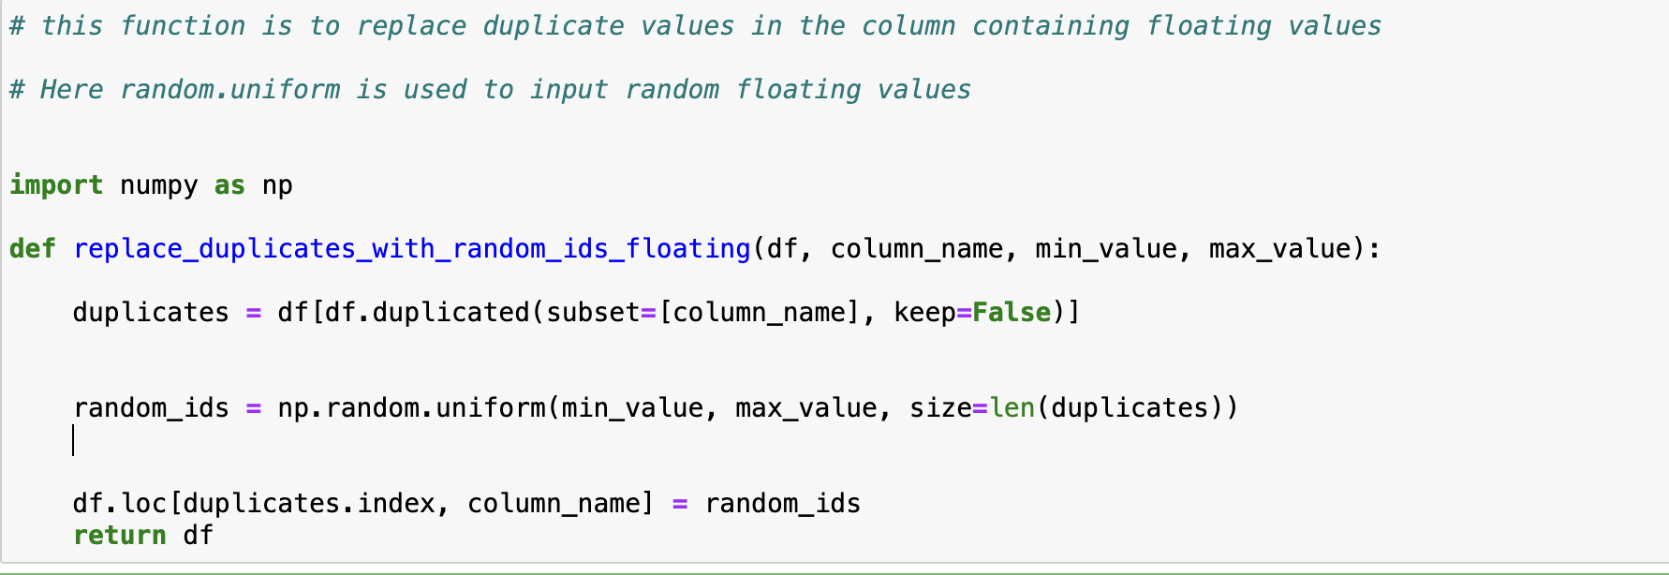
Removing Duplicates for Floating dtypes

Slide 7
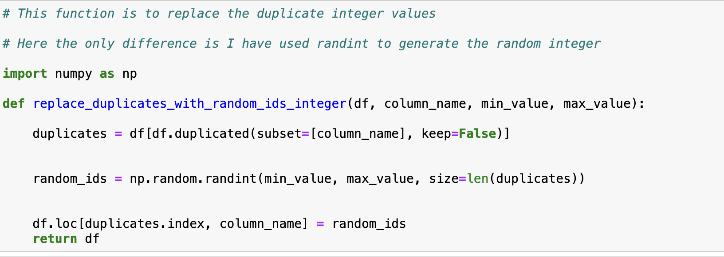
Removing Duplicates for Integer dtypes

Slide 8
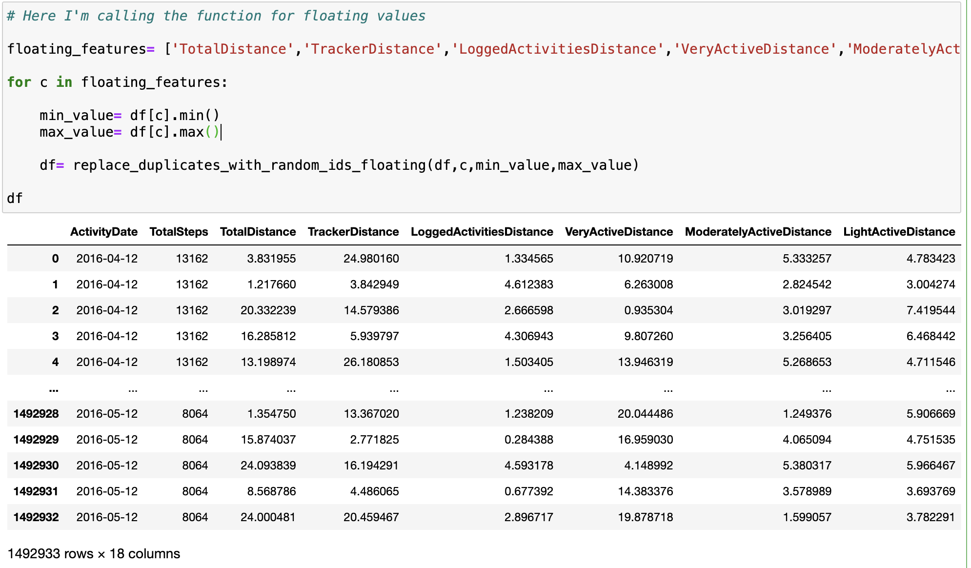
Calling Function for float

Slide 9
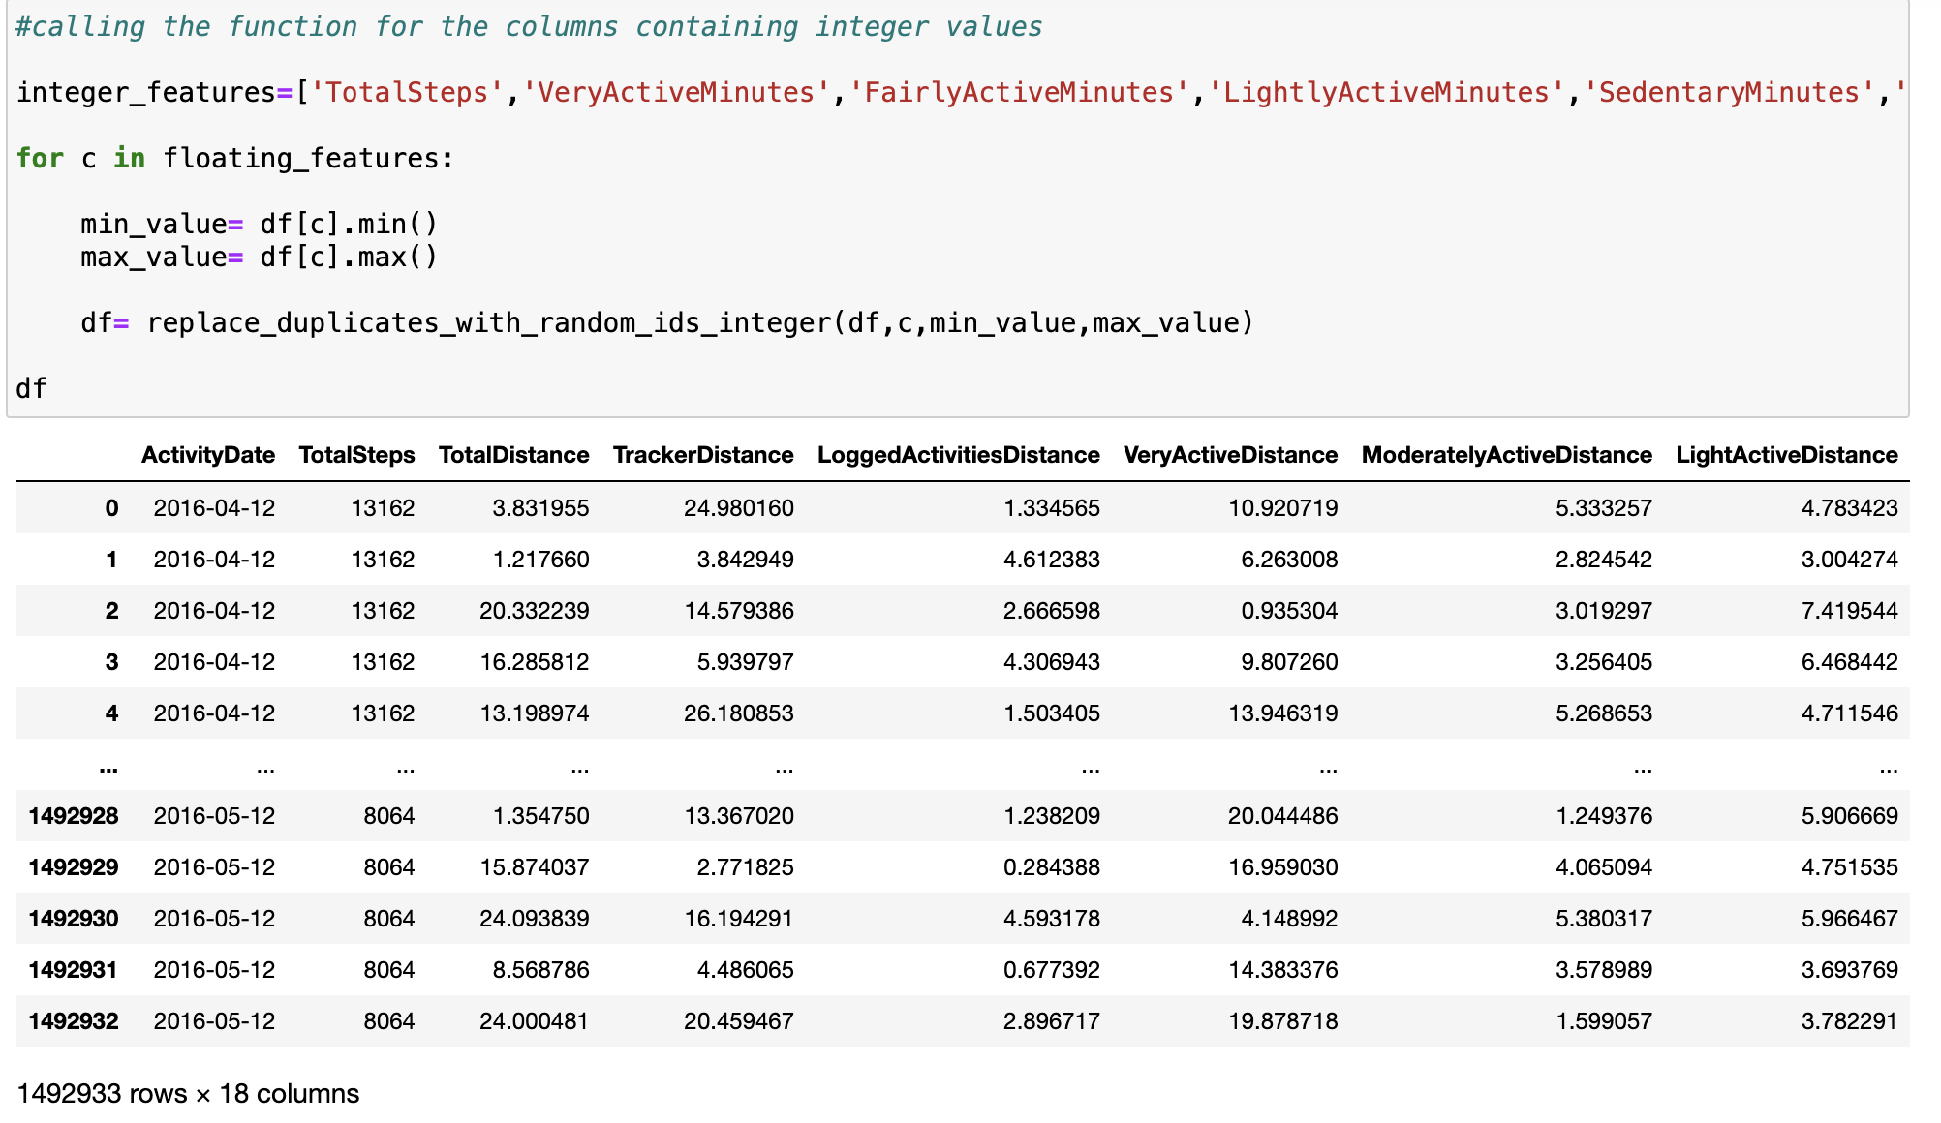
Calling Function for Integer

Slide 10
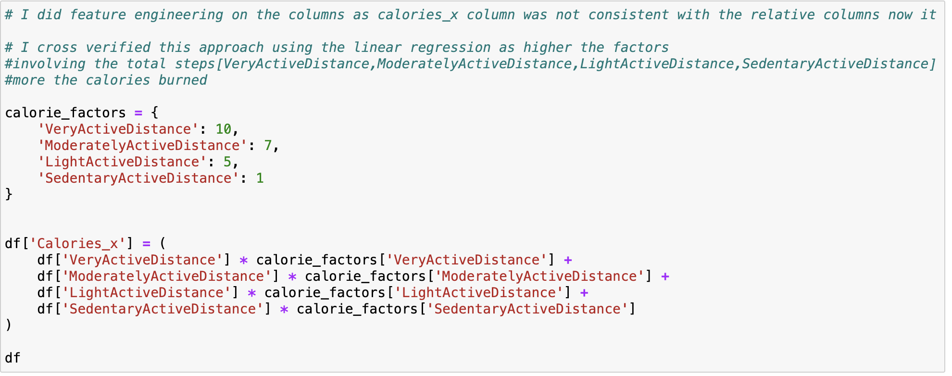
Features not consistent with Calories
Source: Google

Slide 11
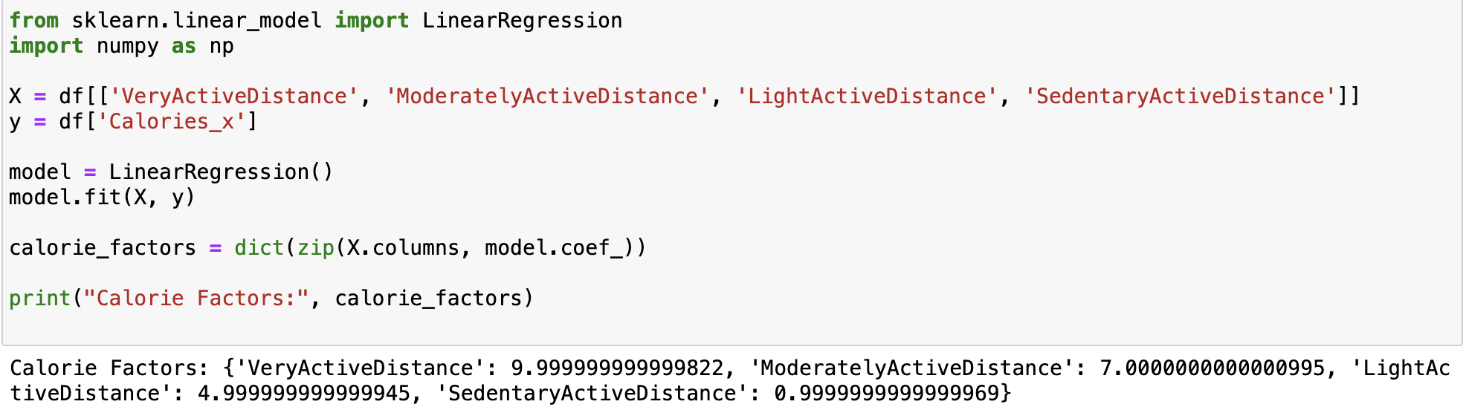
Check for linear relationship

Slide 12
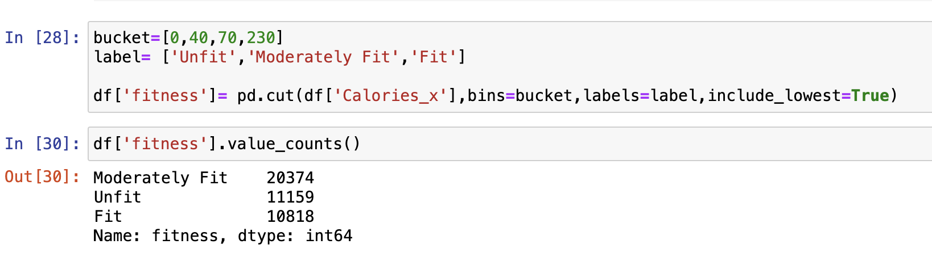
Bucketing the values for target column

Slide 13
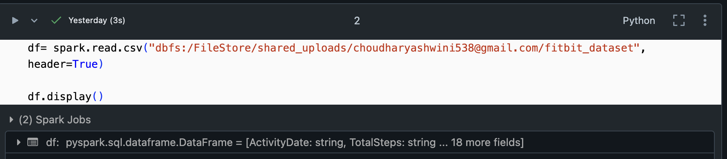
Reading CSV in DataBricks

Slide 14
Applying ANOVA
ANOVA (Analysis of Variance) is a statistical technique used to determine if there are significant differences between the means of three or more groups. In the context of my analysis, I’m using ANOVA to evaluate whether various numerical features (like Calories_x, Steps_per_mile, TotalDistance, etc.) have a significant impact on the target variable fitness, which is categorical (e.g., "fit", "moderately fit", "sedentary").
Null Hypothesis (H₀): There is no significant difference between the means of the feature across the fitness groups. Alternative Hypothesis (H₁): At least one group mean for the feature is different from the others.
p-Value: The p-value tests the null hypothesis. A p-value lower than 0.05 suggests that the feature significantly influences the target variable (fitness), meaning you can reject the null hypothesis.

Slide 15
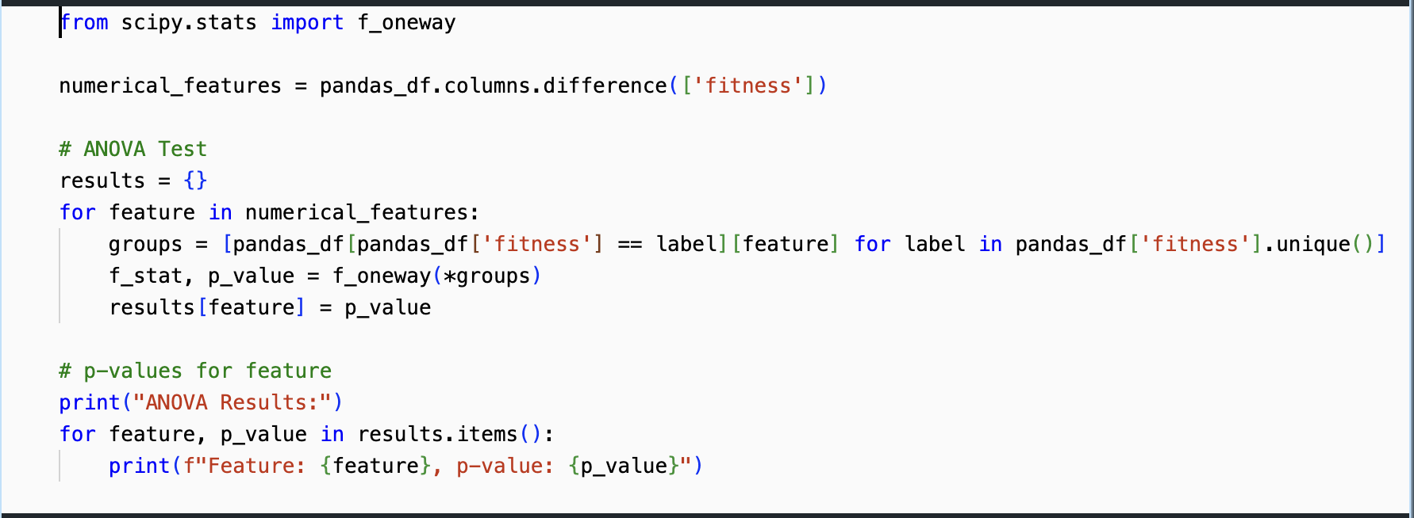
Applying ANOVA

Slide 16
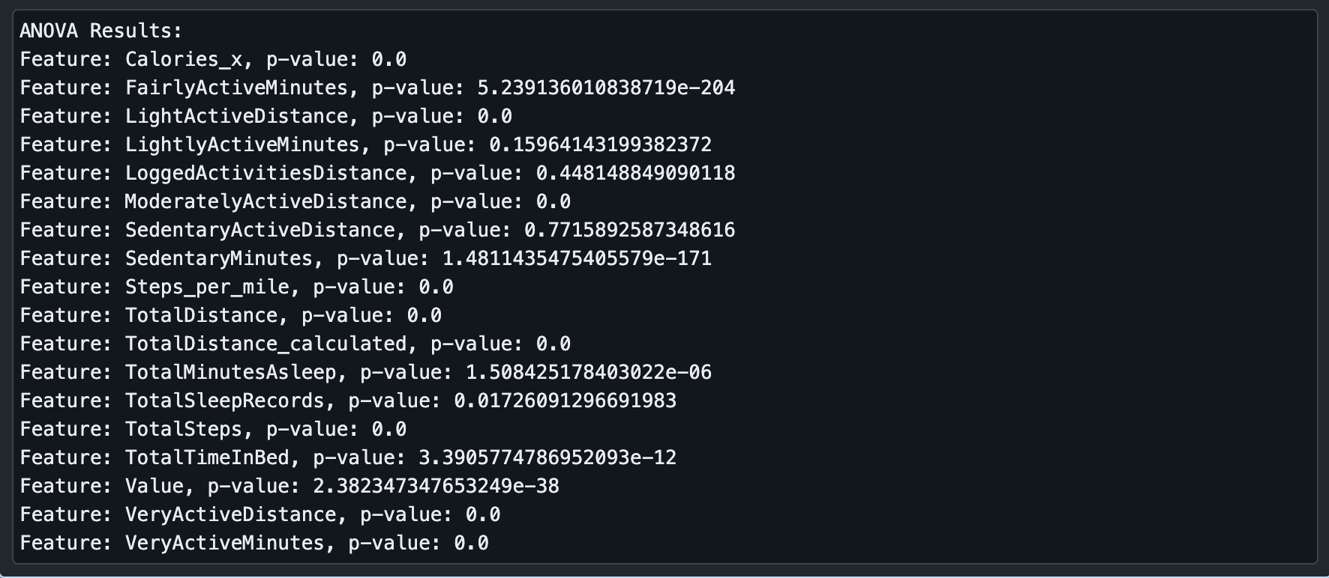
Results of ANOVA

Slide 17
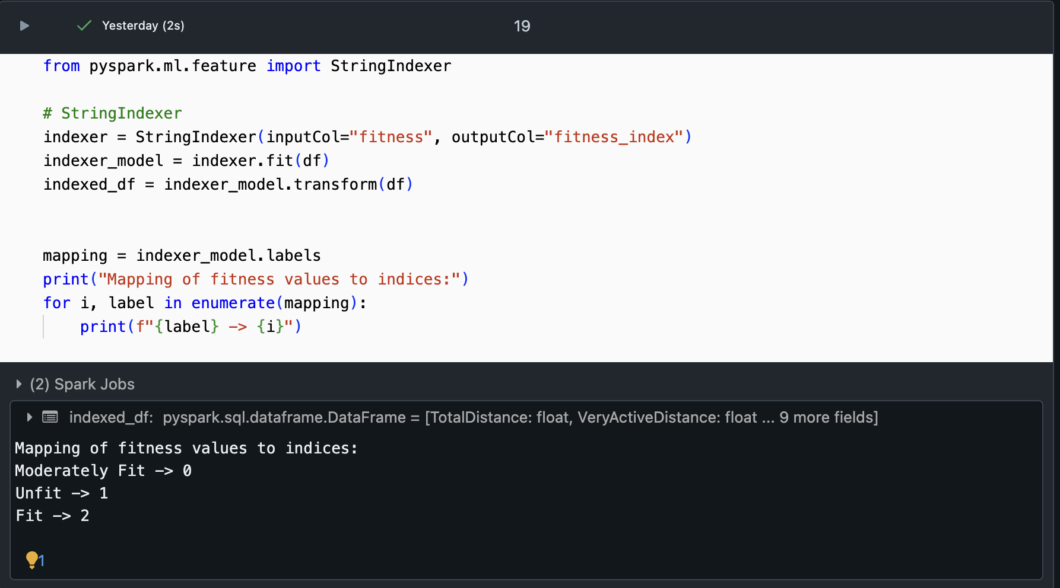
Indexing the target column

Slide 18
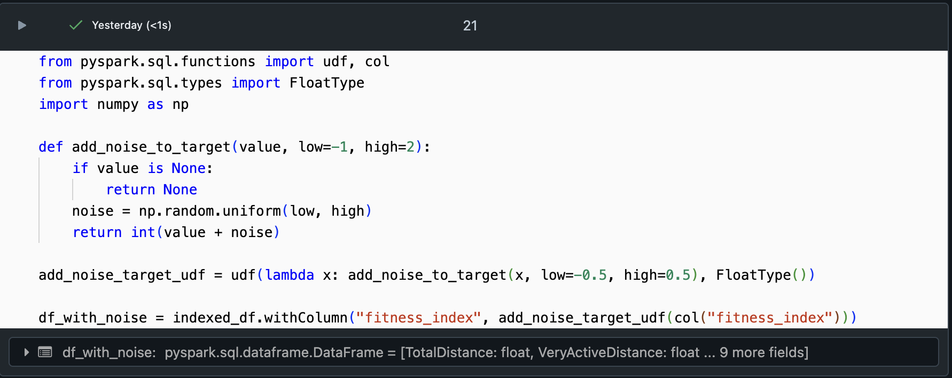
Too much linearity in the dataset – Add Noise
Added noise to target column

Slide 19
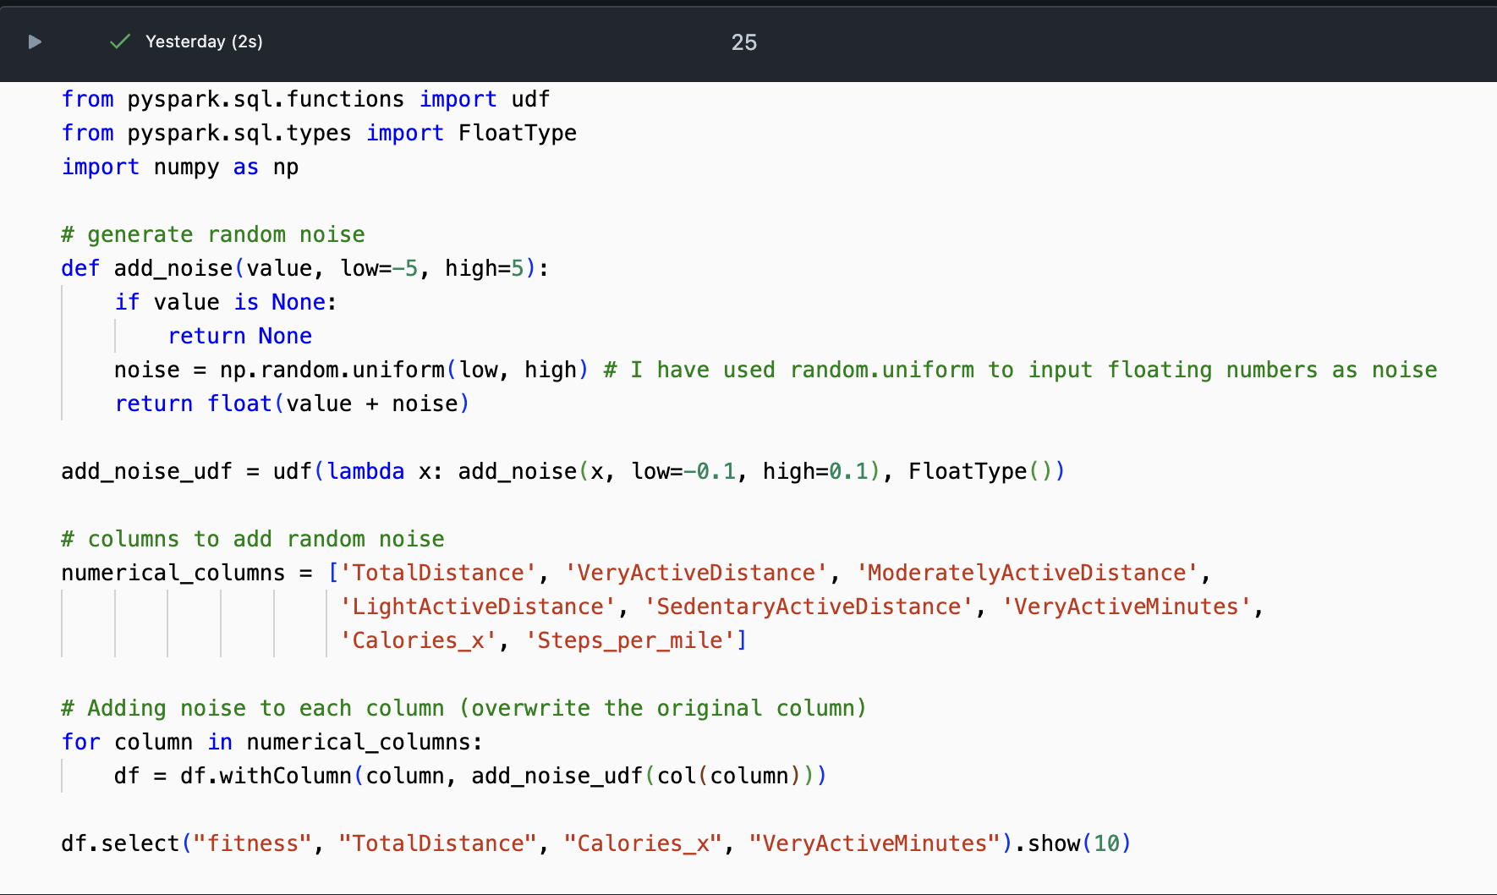
Too much linearity in the dataset – Add Noise
Added noise to the features

Slide 20
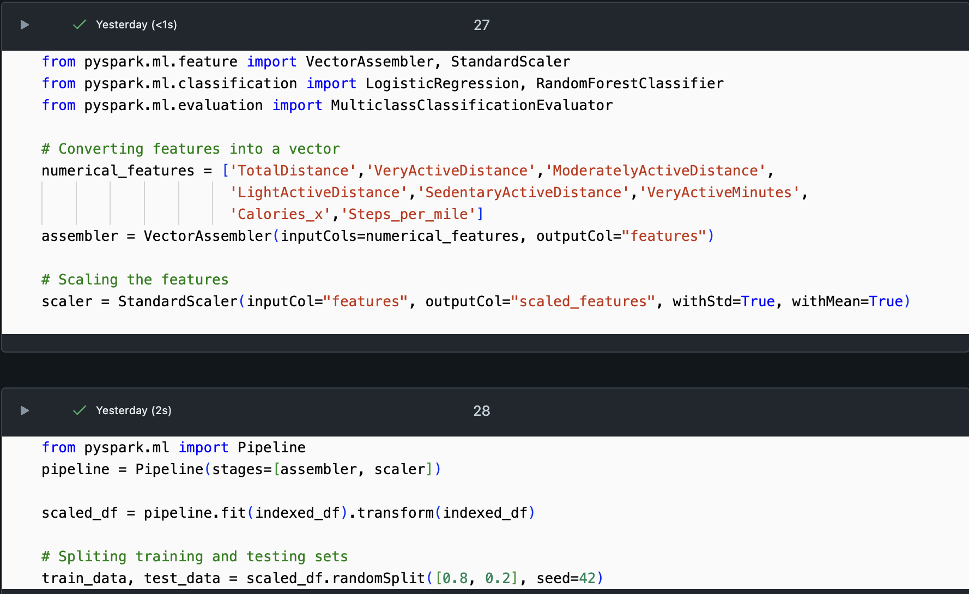
Scaling the Data and Splitting the data

Slide 21
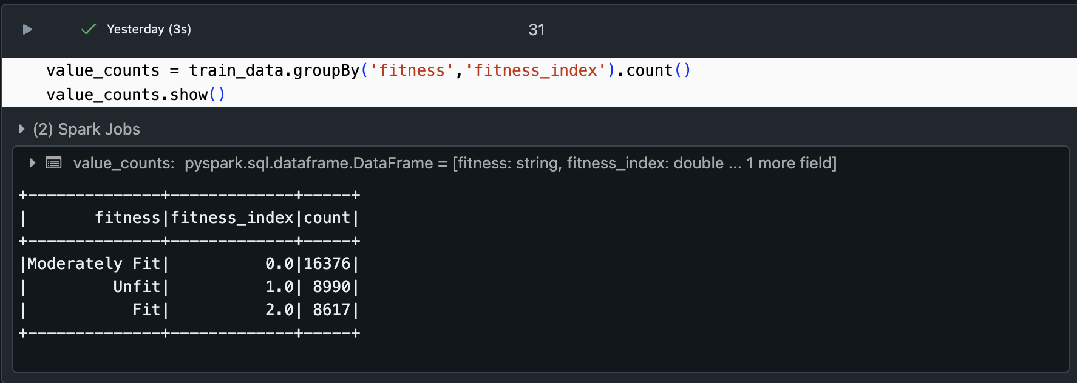
Is my training dataset balanced?

Slide 22
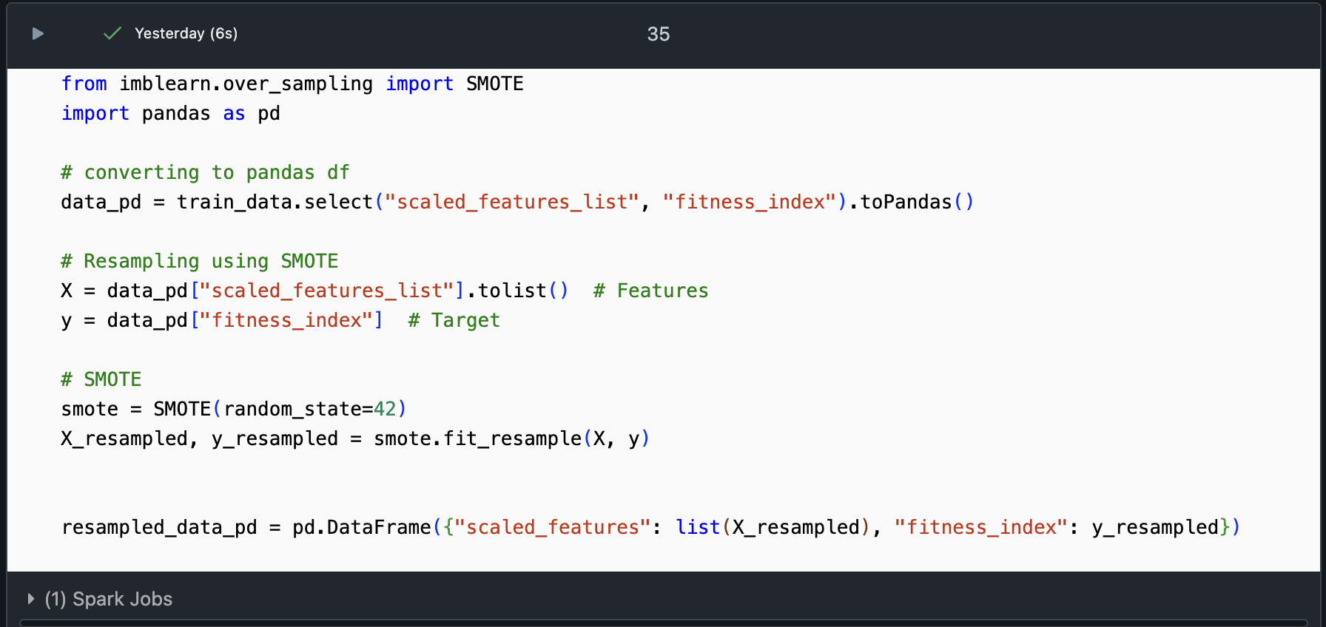
Let’s balance it using SMOTE
SMOTE: Synthetic Minority Oversampling Technique

Slide 23
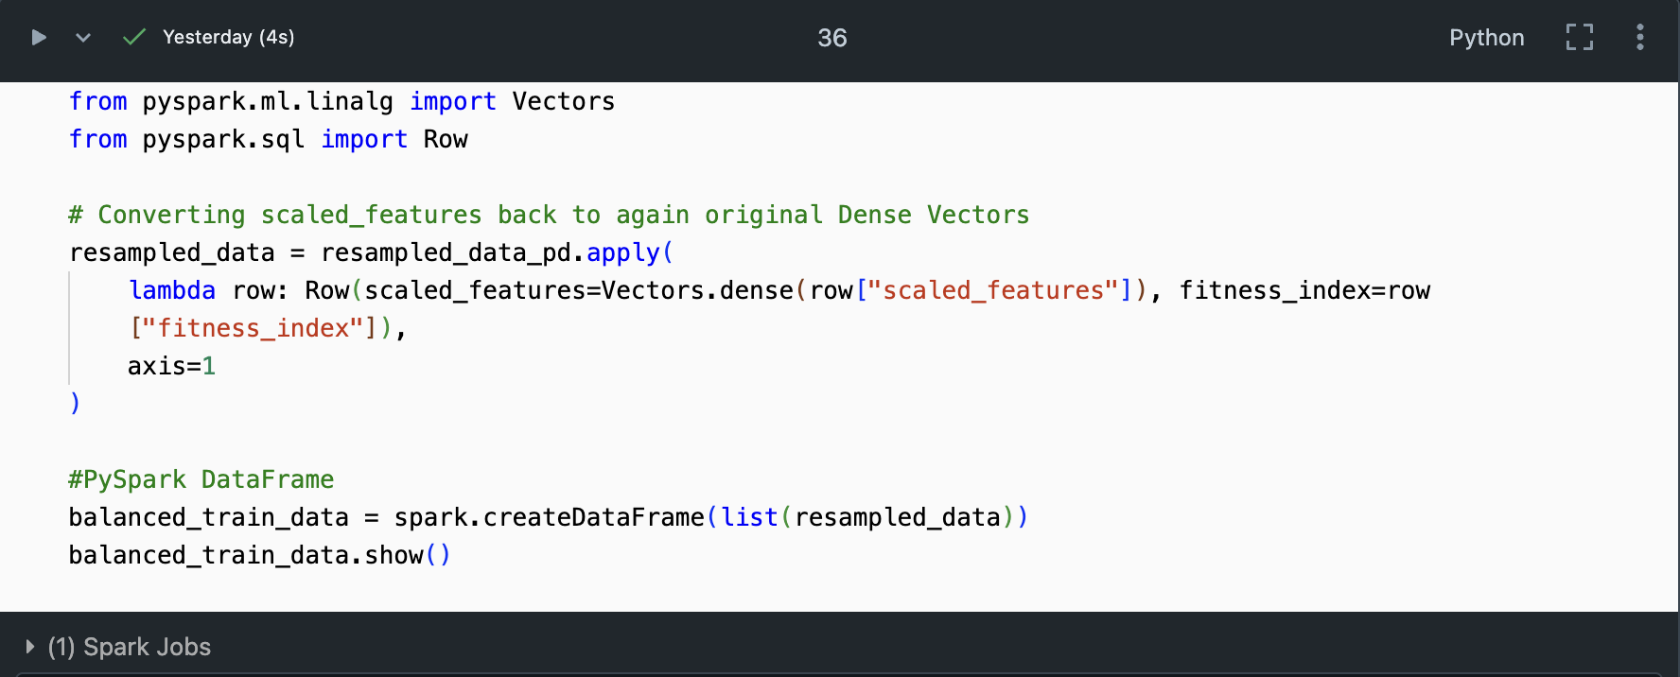
Converting back to dense vectors

Slide 24
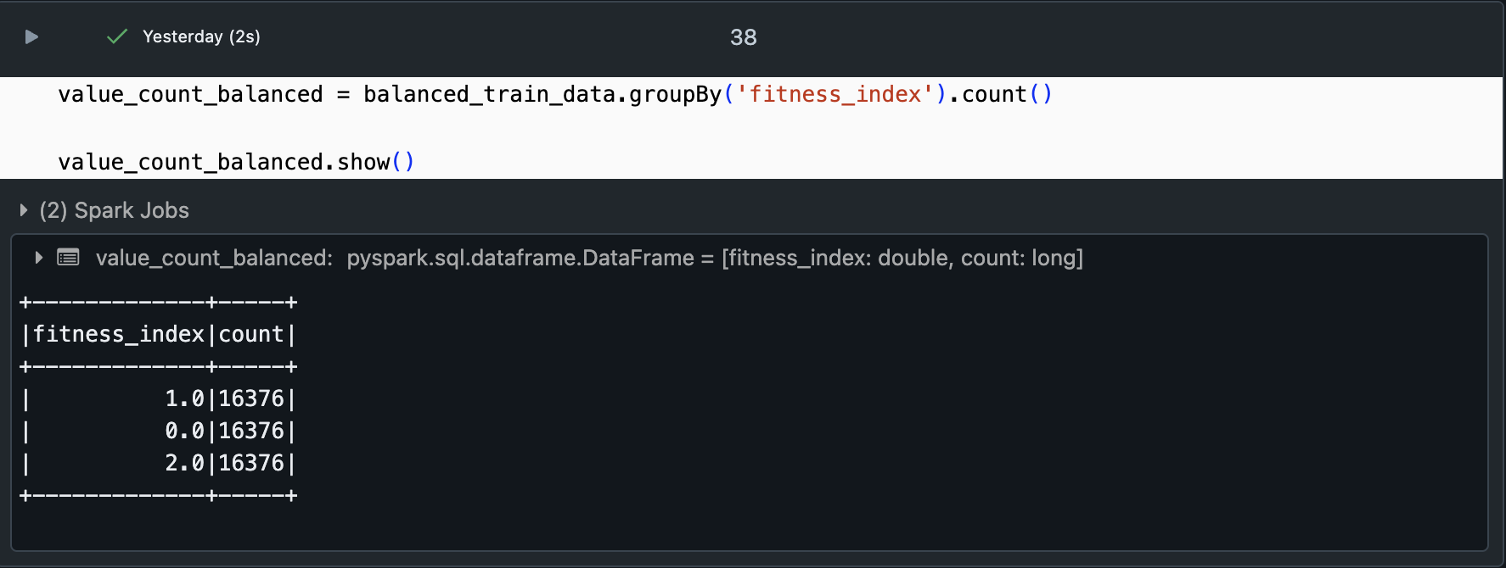
Now the training data is balanced

Slide 25
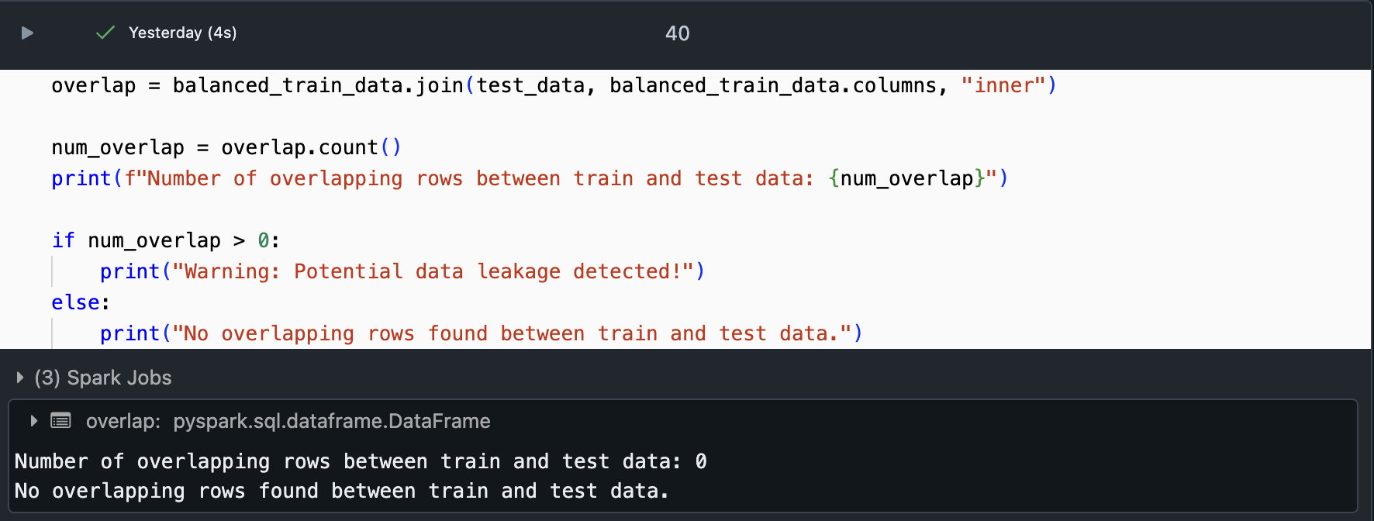
Cross Verify the duplicity for data leakage

Slide 26
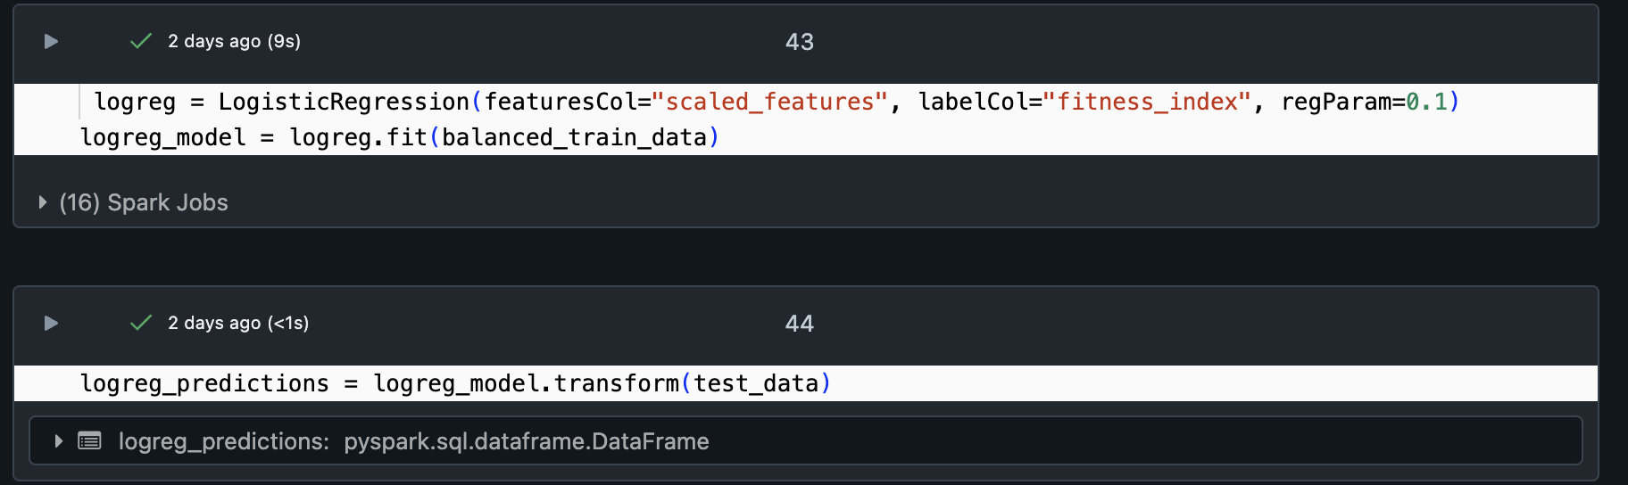
Base Model – Logistic Regression

Slide 27
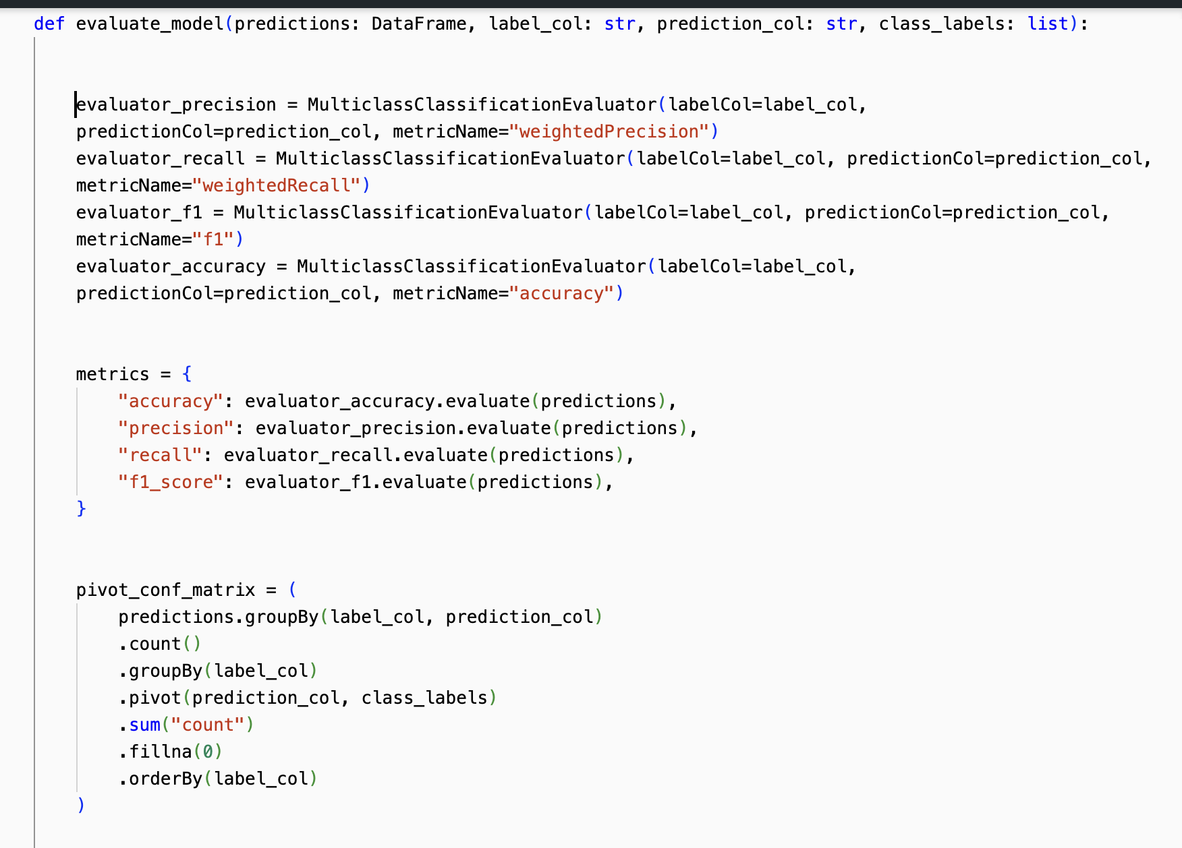
Function for evaluation

Slide 28
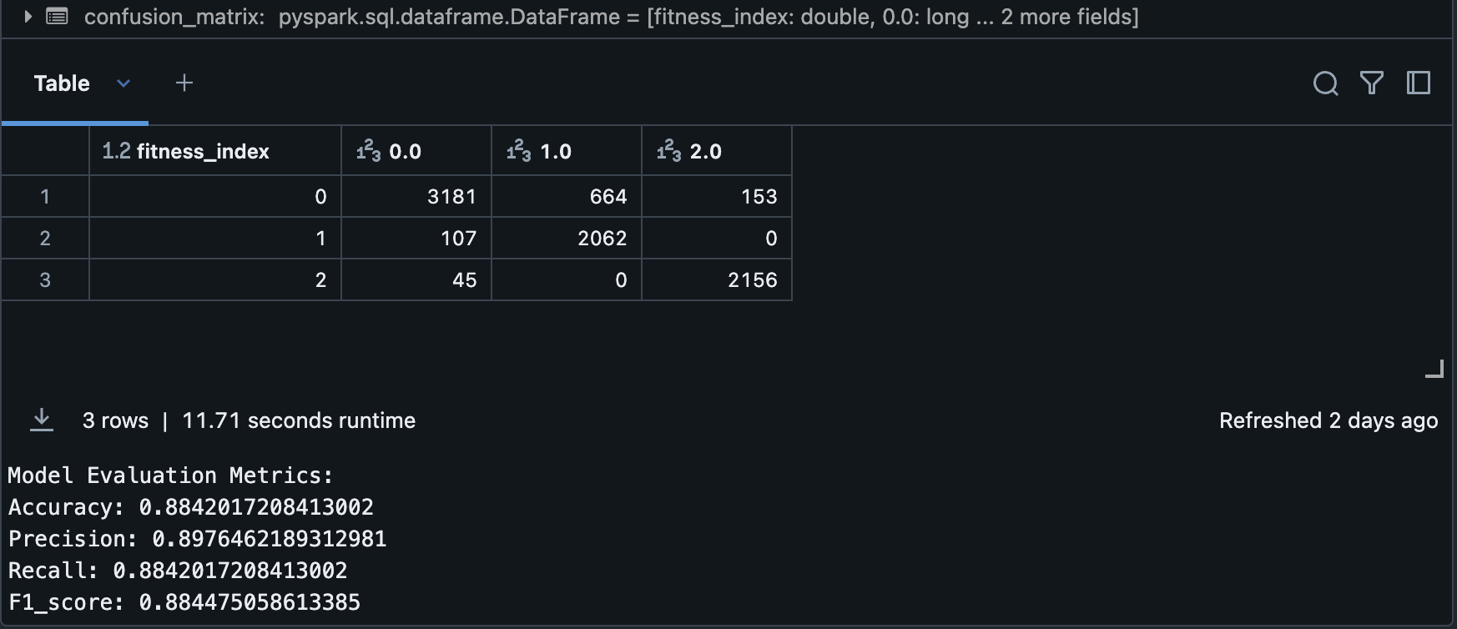
Performance

Slide 29
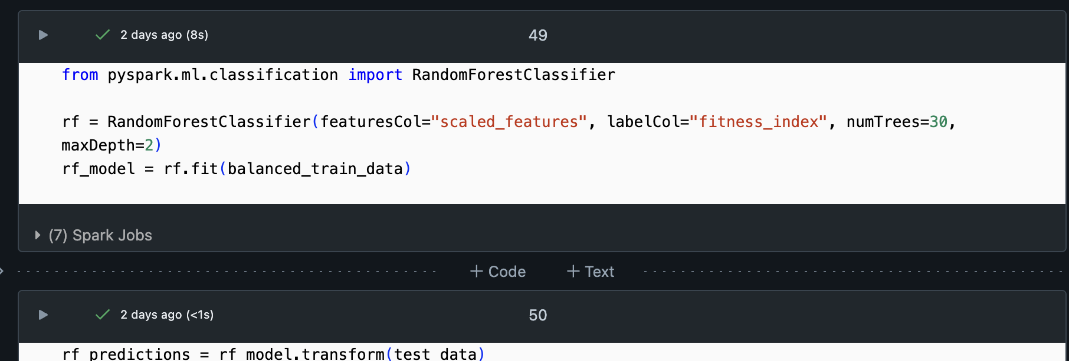
Random Forest

Slide 30
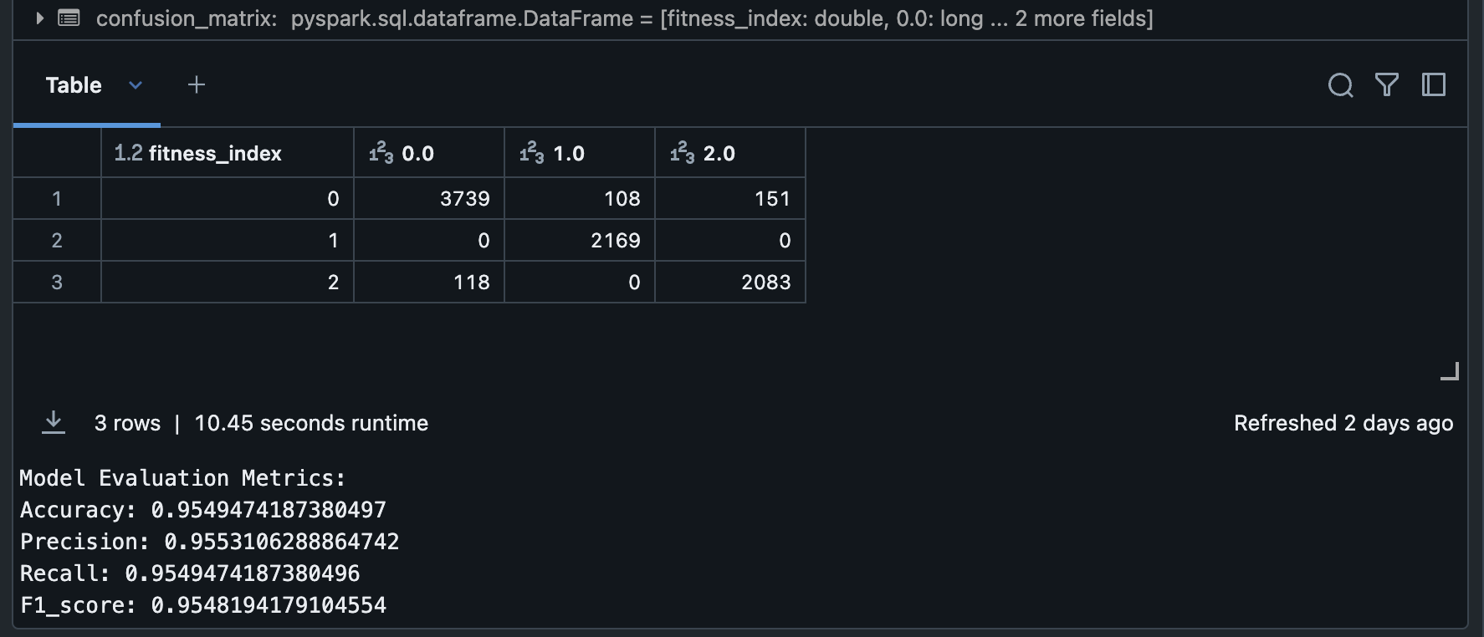
Performance

Slide 31
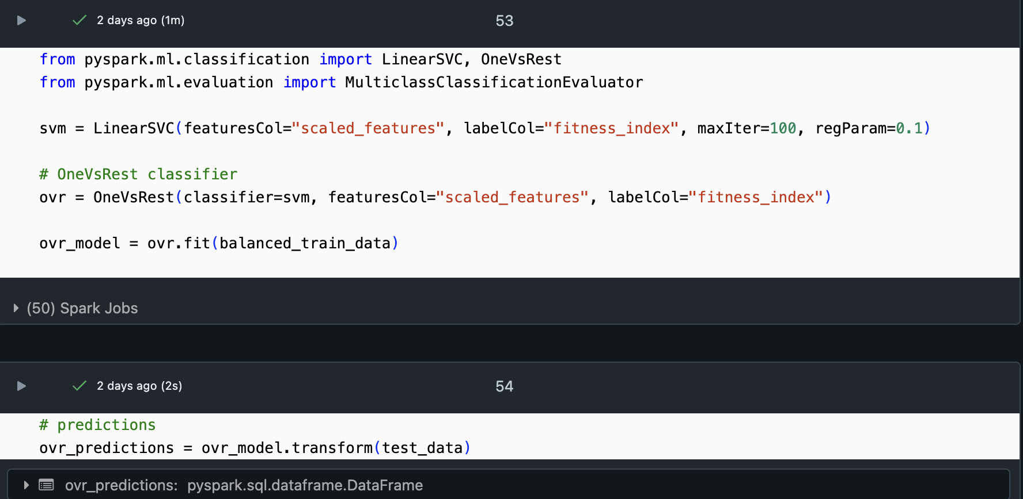
SVM (OvR)

Slide 32
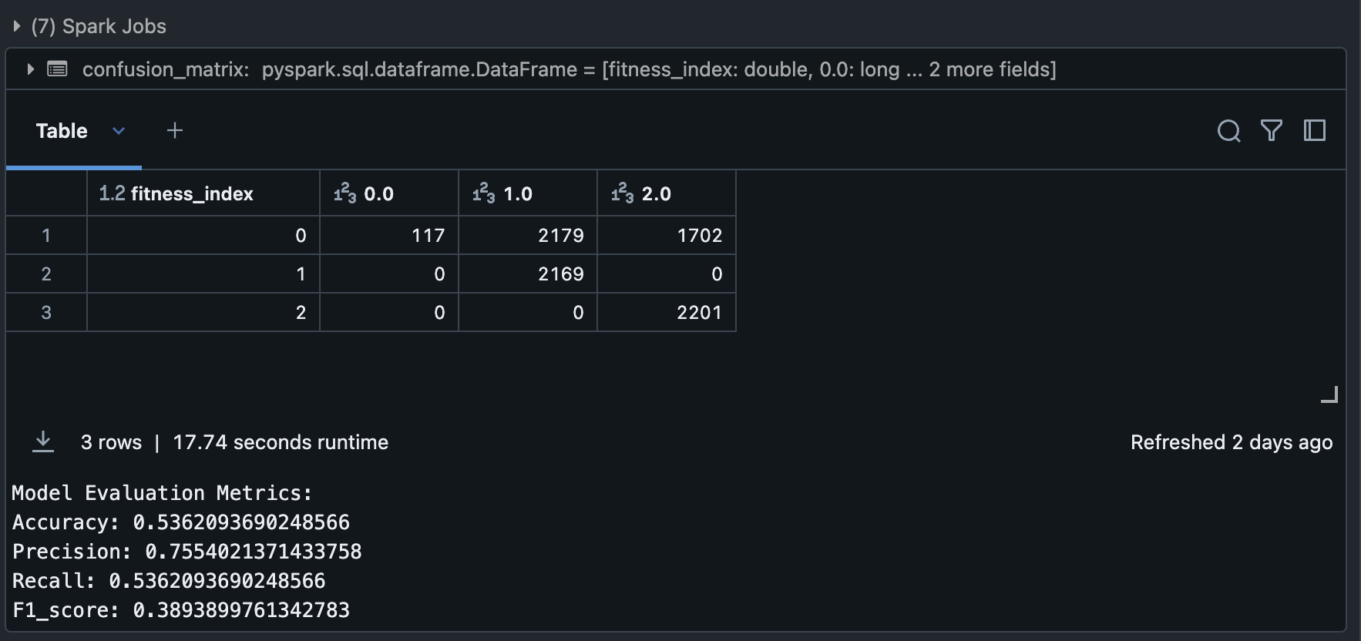
Performance

Slide 33
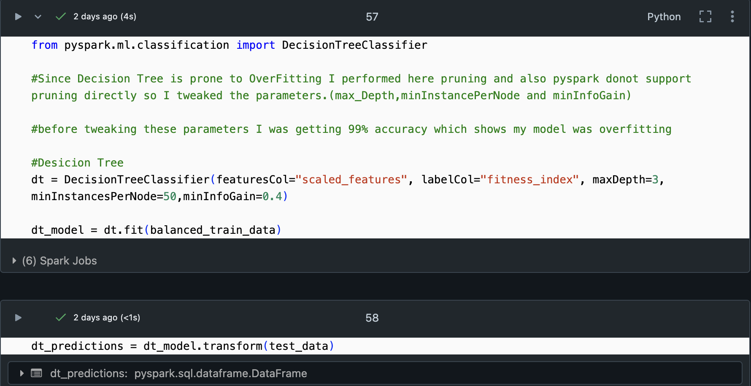
Decision Trees

Slide 34
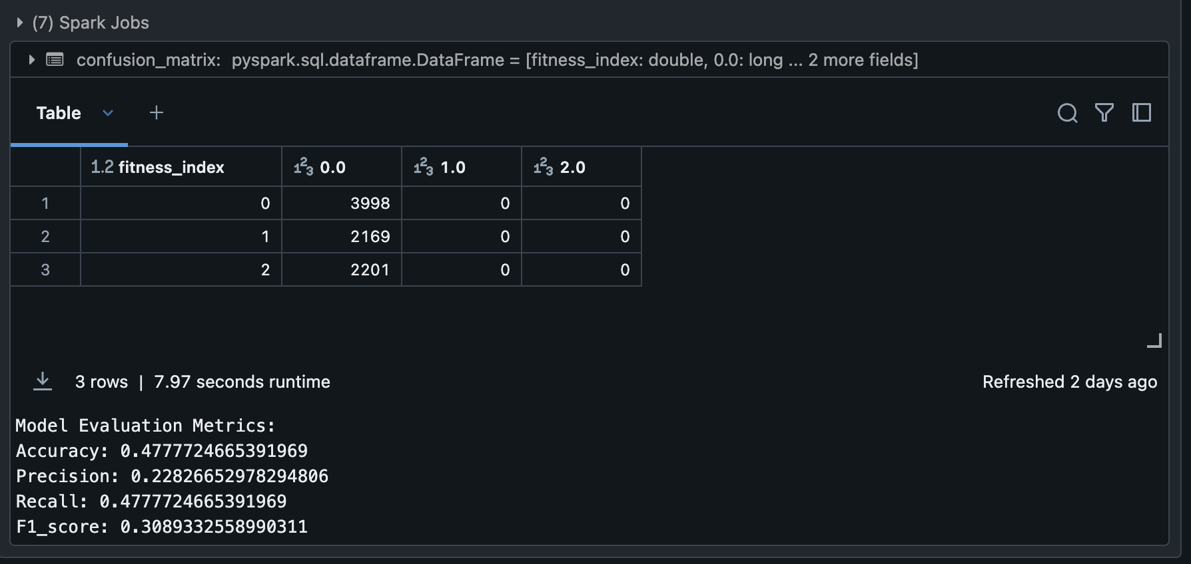
Performance

Slide 35
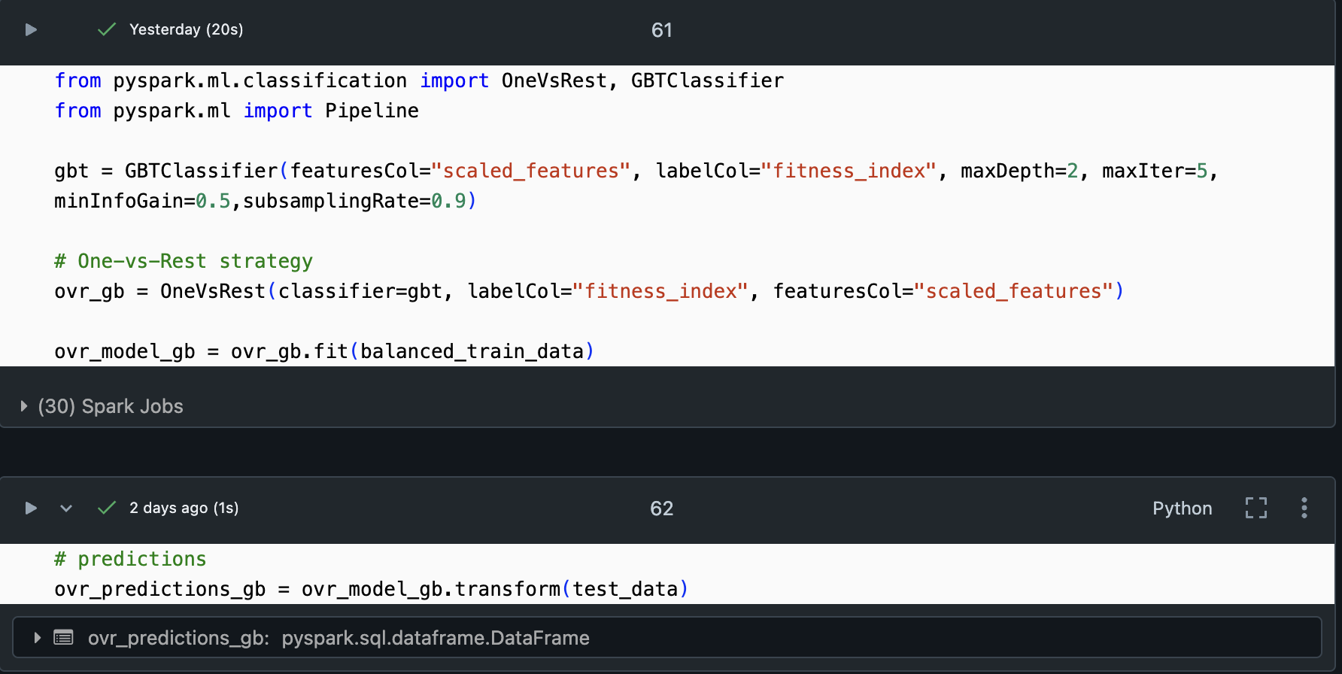
Gradient Boosting

Slide 36
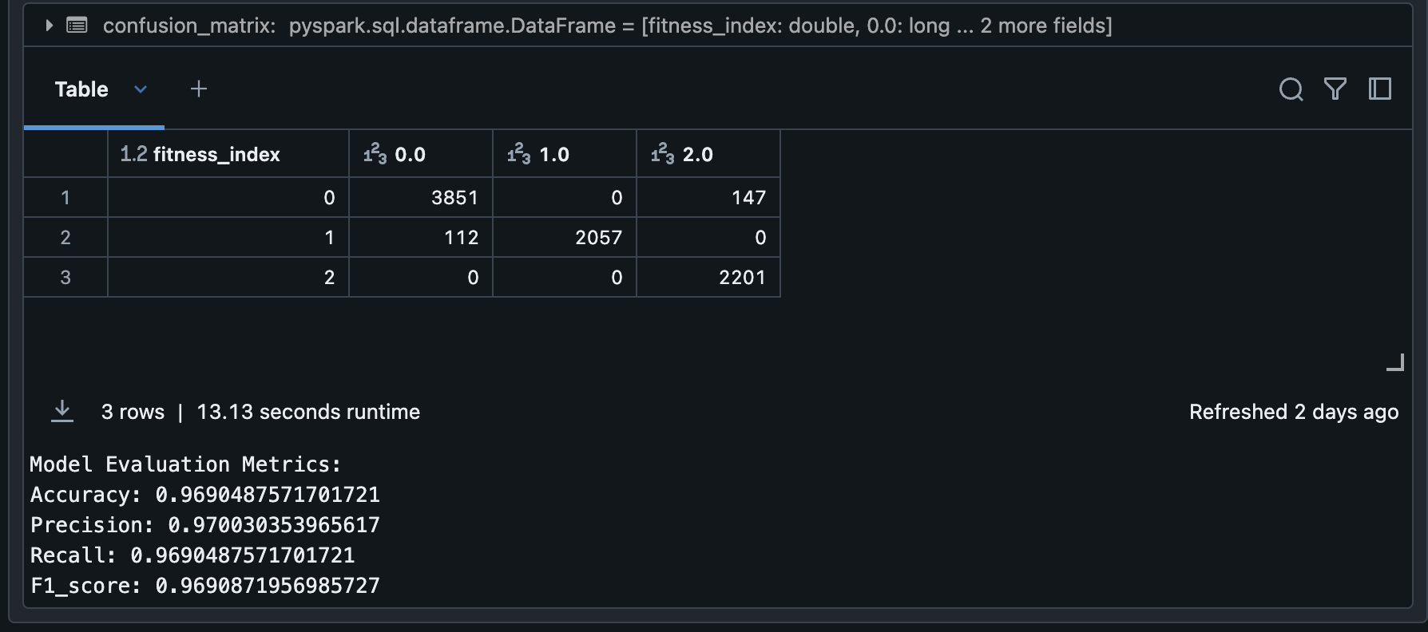
Performance

Slide 37
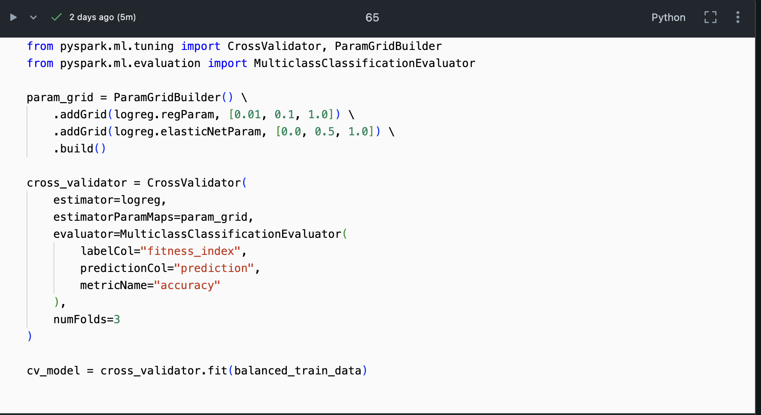
Cross Validation – Logistic Regression

Slide 38
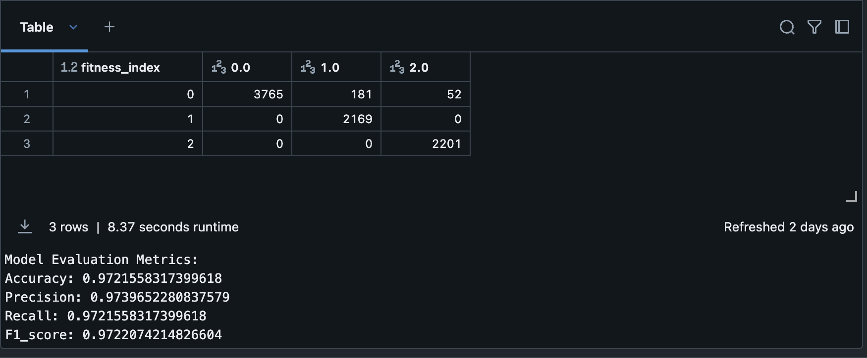
Performance

Slide 39
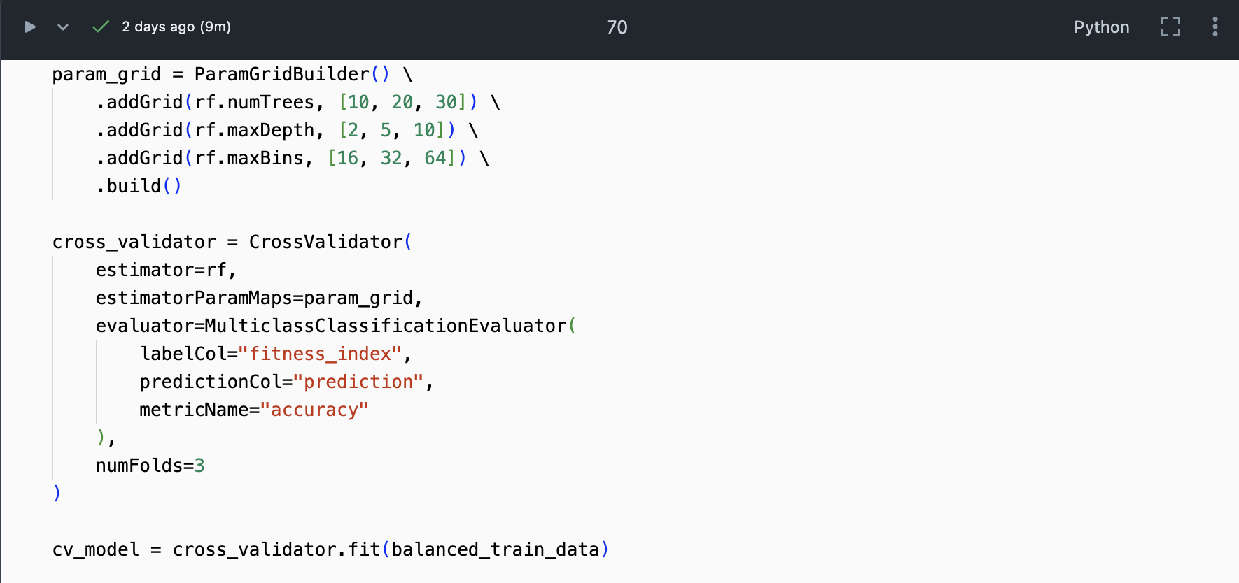
Cross Validation – Random Forest

Slide 40
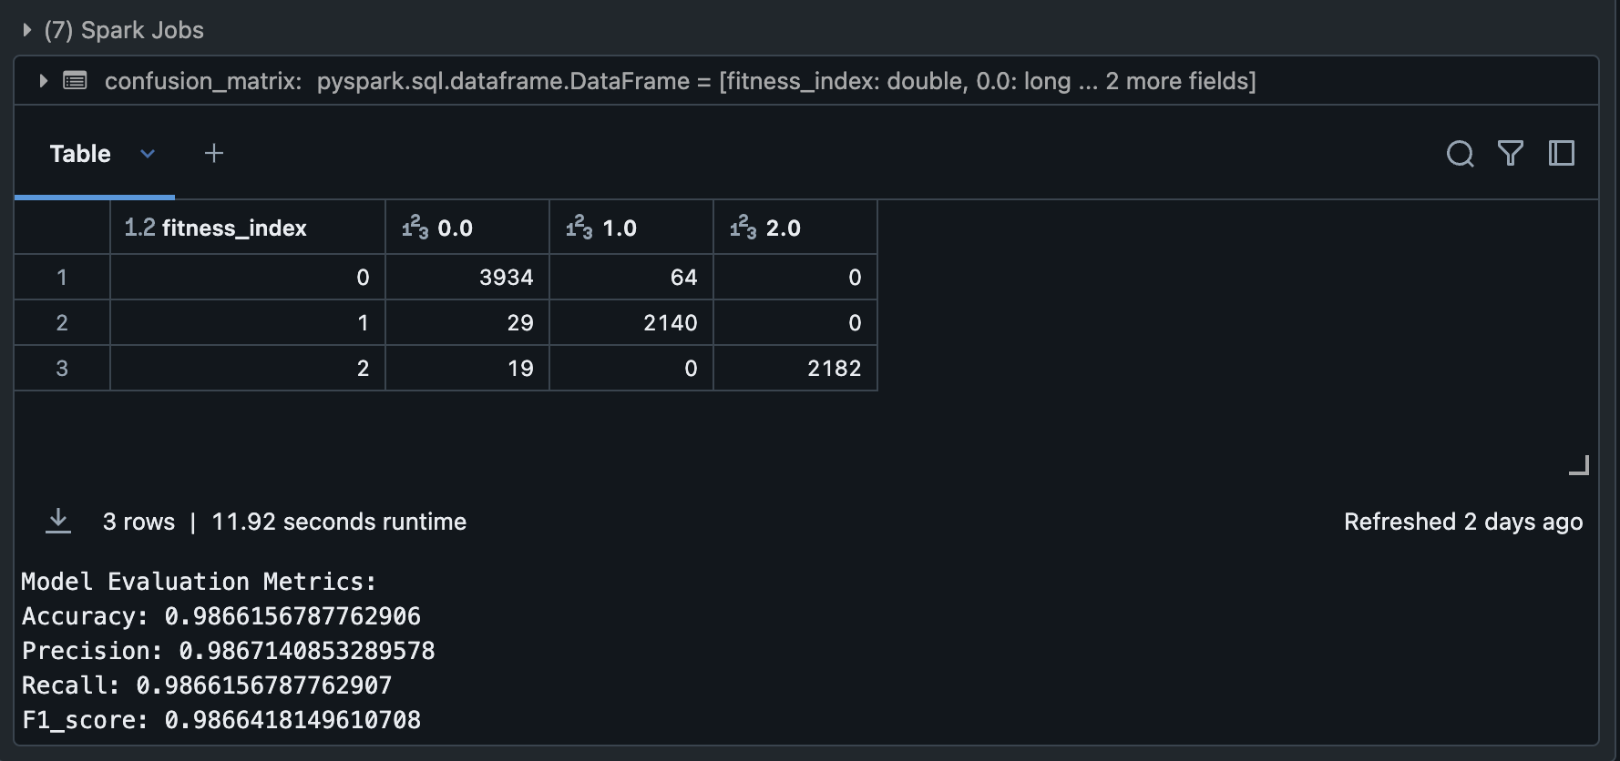
Performance

Slide 41
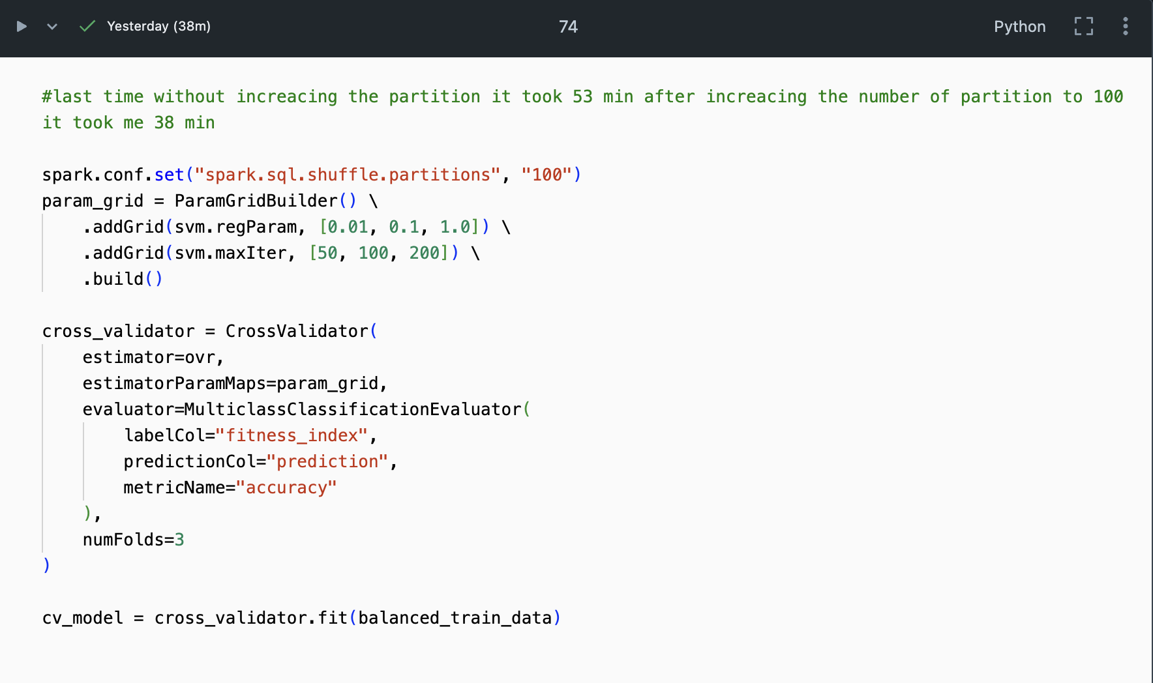
Cross Validation - SVM

Slide 42
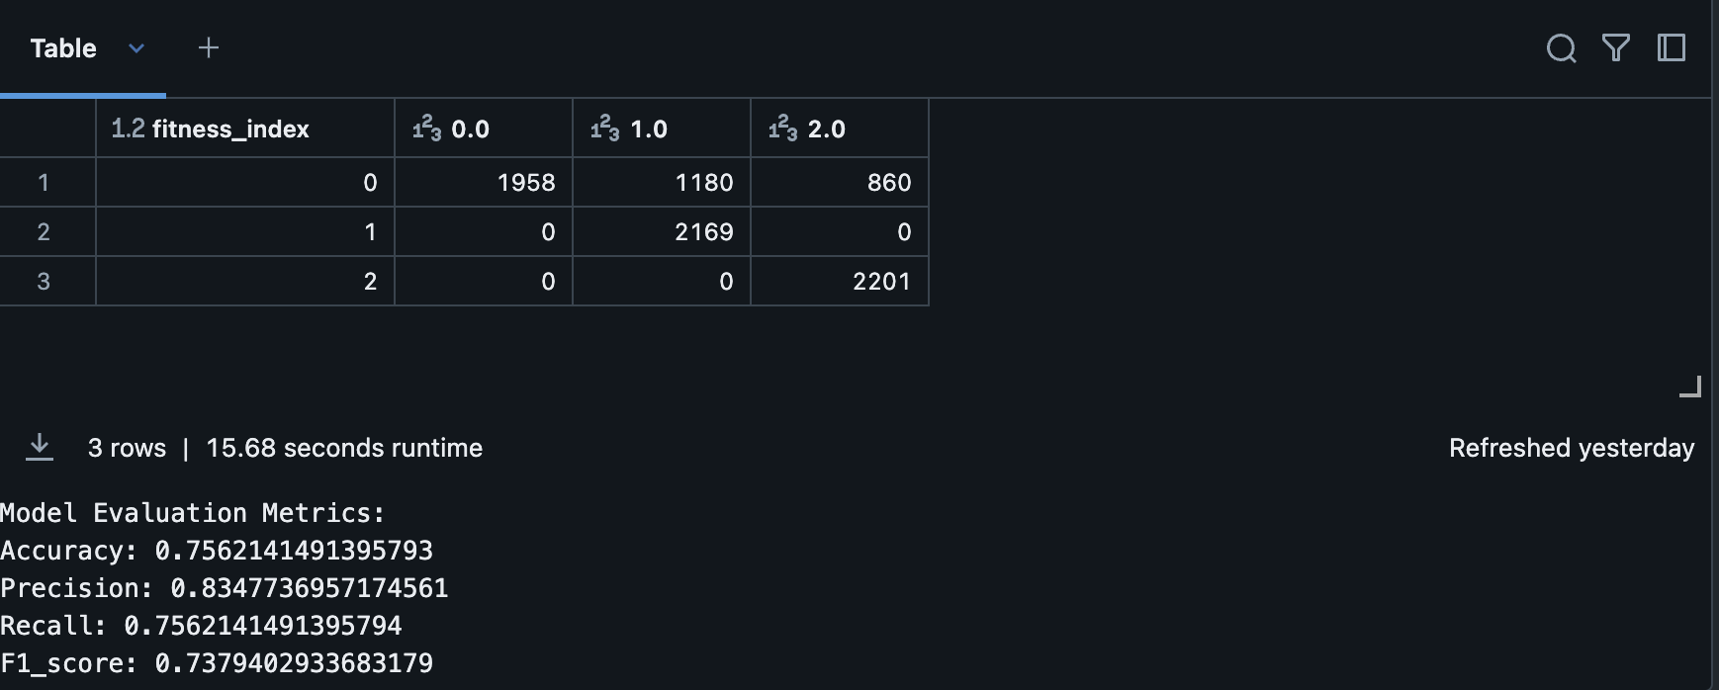
Performance

Slide 43
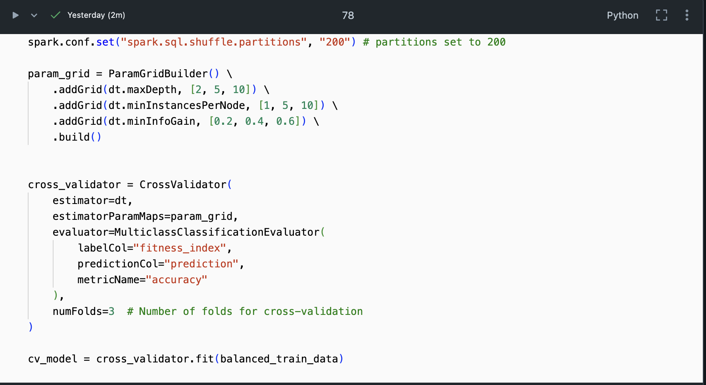
Cross Validation- Decision Trees

Slide 44
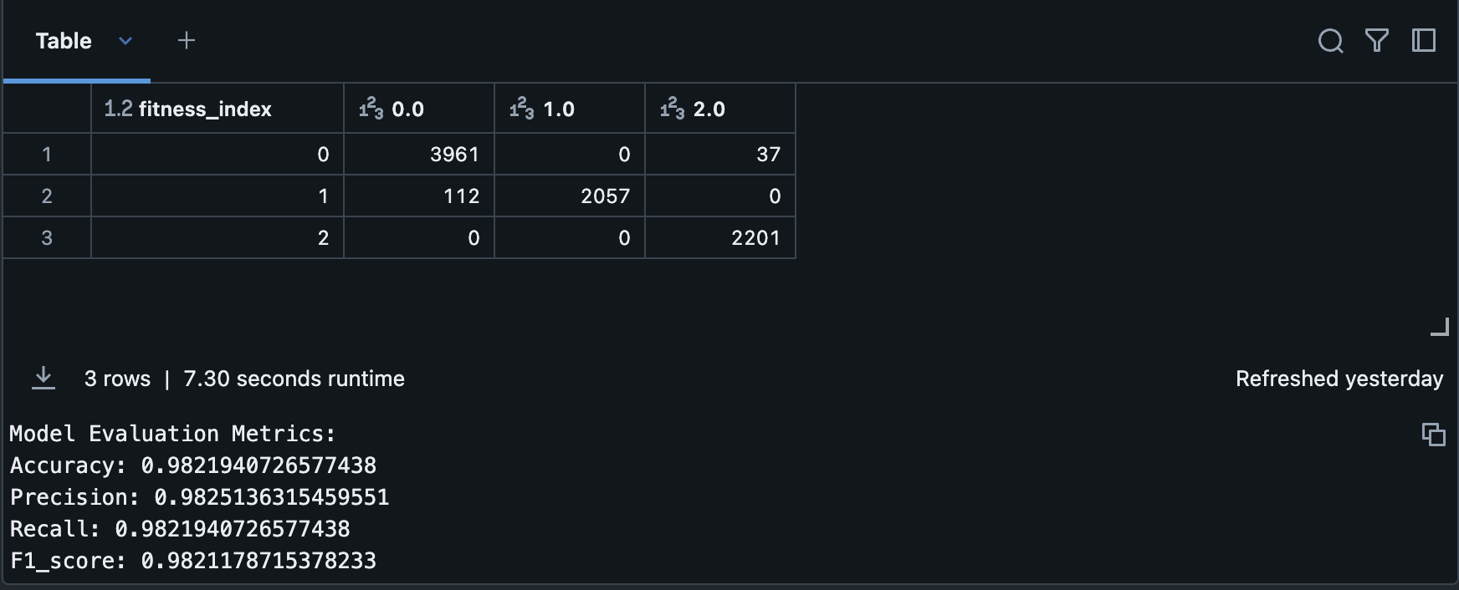
Performance

Slide 45
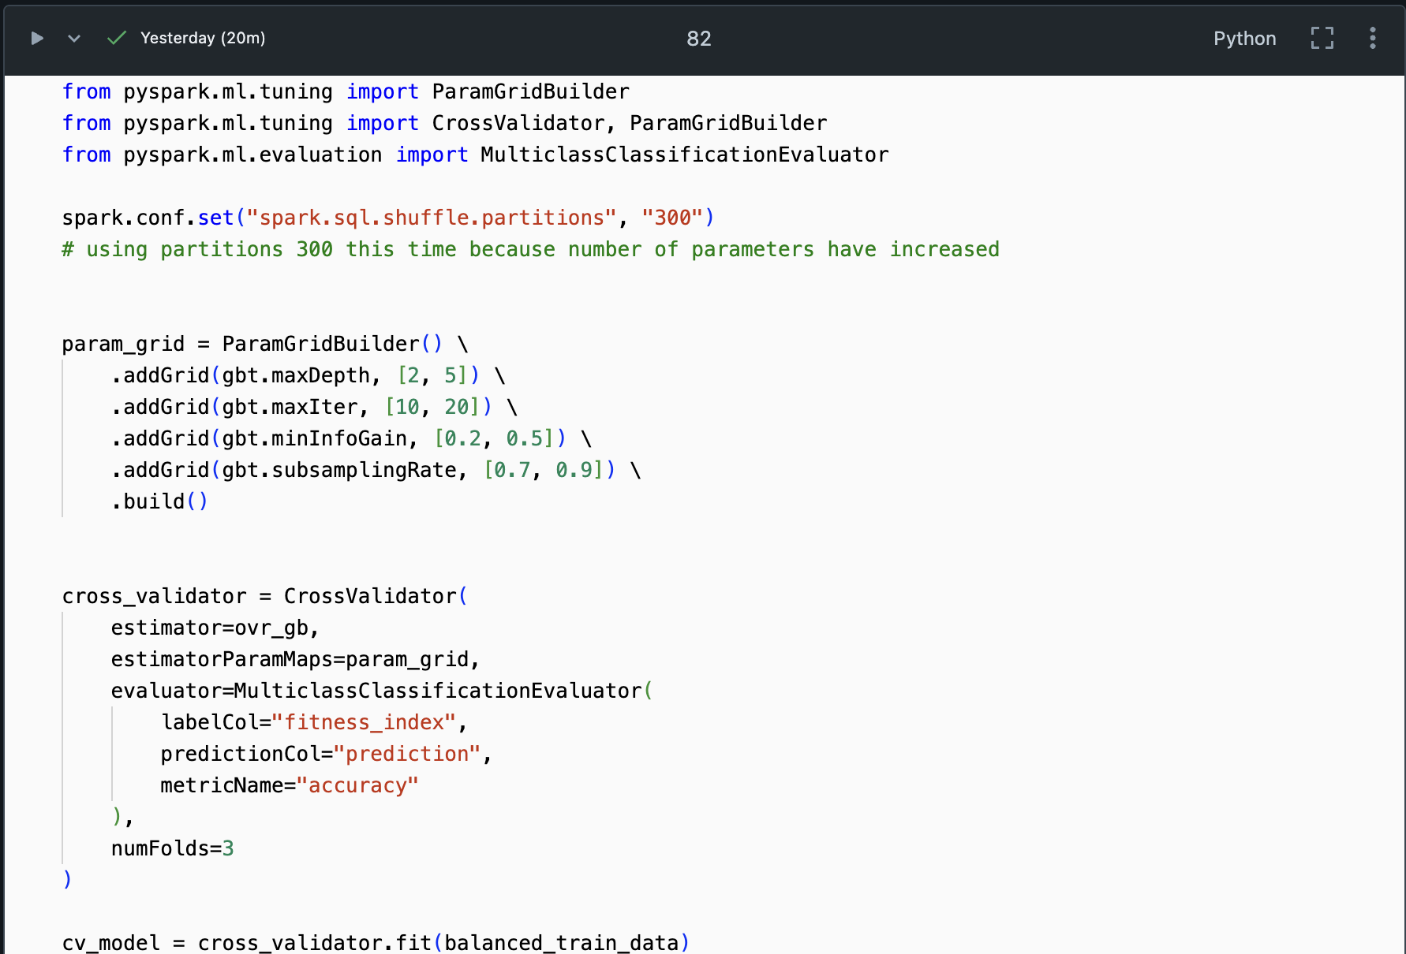
Cross Validation – Gradient Boosting

Slide 46
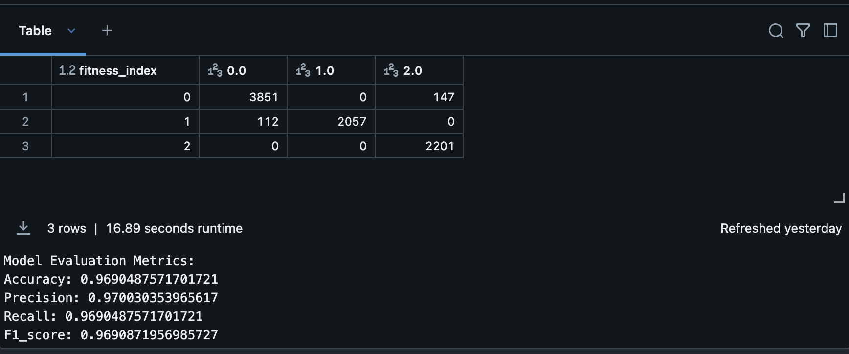
Performance

Slide 47
Conclusion
In conclusion, after evaluating multiple machine learning algorithms, the Random Forest model emerged as the most effective in predicting the fitness index, achieving an impressive accuracy of 98%.
The Support Vector Machine (SVM) model showed a notable improvement, with its accuracy jumping from 53% to 75%
The Decision Tree classifier also displayed a significant enhancement, with its accuracy increasing from 47% to 97% after cross-validation and tuning.
Overall, while Random Forest performed the best, the improvements in both SVM and Decision Tree accuracy underscore the value of using cross-validation and parameter tuning to optimize model performance.

